Slide 1
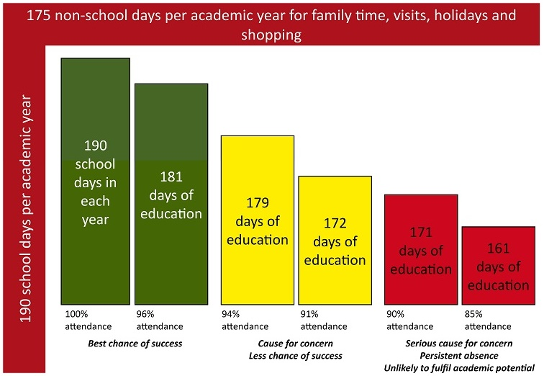
OCR Level 02 – Cambridge Technical
Unit 03 - Building IT Systems
2016 Specification - T/615/1382
LO2 - Be Able to Design IT Systems to Meet Business Needs

Slide 2
Assessment Criteria
The Learner will | Pass The assessment criteria are the pass requirements for this unit. The learner can: | Merit To achieve a merit the evidence must show that, in addition to the pass criteria, the learner is able to: | Distinction To achieve a distinction the evidence must show that, in addition to the pass and merit criteria, the learner is able to:
1. Understand the roles of IT technical support | P1 - Explain the role of an IT support technician in an organisation |  | D1 - Compare the activities of different IT technician roles
2. Be able to design IT systems to meet business needs | P2: Propose an IT system to meet specified business needs | M1 - Justify how the design meets the specified business needs
3. Be able to select the components for the designed IT systems | P3 - Select the hardware components for the proposed IT system | M2 - Justify why the selected components meet the proposed Specification
 | P4 - Select the software for the proposed IT system
4. Be able to build and configure IT systems to meet business needs | P5 - Build and test the IT system | M3 - Carry out acceptance testing with the client | D2 - Evaluate the results from testing and recommend improvements
 | P6 - Configure and test the IT system

Slide 3
Aim and Purpose
e
Learning Outcome 2: Be able to design IT systems to meet business needs.
Your task is to: design an IT system that can be used by the teaching staff of Progress Academy.
With reference to the list of requirements from Progress Academy you must propose an IT system that will fulfil the specific needs of the end user. Your system does not need to meet all of the requirements but should focus on a specified area e.g. the student registration system, the monitoring of student grades or the control of stock and resources in the Academy. You will need to clearly identify the business requirements that must be considered to ensure the suitability of your IT system. Your proposal should include cost, security and recovery methods.
Your proposed IT system will be presented to the client (the Progress Academy SMT) for approval and so you will need to clearly explain how your proposed IT system will be ‘fit for purpose’ and suitable for the end users i.e. the teaching staff.

Slide 4
Assessment Criterion P2, M1
P2.1 - Business Requirements, i.e.:
purpose
viability
intended users
cost
hardware and software equipment
security
recovery

Slide 5
Assessment Criterion P2, M1
P2 - Learners must propose an IT system to meet a specified business need. Learners are to be given a list of requirements from a potential client and must
identify the components required to meet these needs. To evidence this, learners could source the components online and present their ideas to the class.
M1 - Learners are required to justify how the design from P2 meets the specified business needs. Learners will expand on P2 to justify the rationale for each component identified in the design. To evidence this, learners could produce a table and outline which business need each component satisfies.
Why do teachers do registers each lesson What happens if my attendance drops below 95%. Who will know? What Management System does my school have Can I see my own grades How much data is automated and how much needs to be typed.

Slide 6
Assignment Scenario
In order for any organisation to run effectively and successfully achieve its targets a range of supporting systems will need to be used.
It is now common practice that the vital systems within an organisation are automated and computer controlled which promotes accuracy and efficiency.
This has resulted in the increasing need for IT support technicians who are responsible for the design, development, implementation and testing of those systems. The role of an IT support technician requires an enhanced level of knowledge about hardware, software and networks and is now a vital role within most organisations.
Progress Academy – IT support systems
Progress Academy is an education establishment with 500 students. The current systems in the academy are paper-based but the Academy would like to reduce the errors and environmental impact of paper-based systems through the use of automation.
The subsequent use of computer controlled systems will not only have a positive environmental impact but should improve the speed and accuracy at which the systems operate.
The Academy has identified three priority systems that require immediate automation - the student registration system, the monitoring of student grades and the control of stock and resources in the Academy e.g. paper, pens and equipment.

Slide 7
Assignment Scenario
There are also secondary systems which are considered important to the effective daily running of the Academy. These include fault reporting, financial management and building maintenance routines.
The SMT at the Academy has very little experience with the design and implementation of IT systems and so has recently employed an IT support technician who will be responsible for the design and building of the IT support systems within it.
Progress Academy – IT system specification
Progress Academy has stated the priority requirements that their IT system must have. These include:
printing documentation and scanning documents or images;
storing up to 500GB of information and images;
transferring data to hand held devices, e.g. tablets or laptops;
specialist display devices where appropriate;
hosting video conferencing;
a simple and easy to use graphical user interface;
networking functionality to enable files transfer and sharing;
a range of suitable software applications appropriate for teaching staff and students;
internet access including appropriate security measures;
authorised user only access;
appropriate backup and recovery systems.

Slide 8
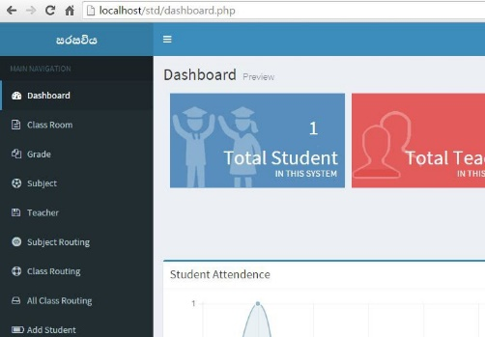
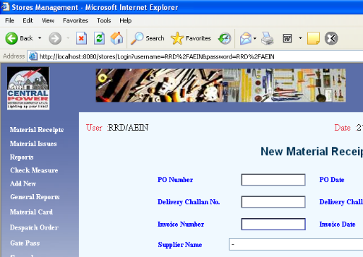
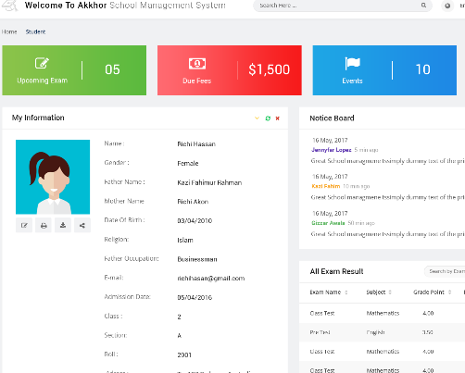
P2.1 – IT System Proposal
The current systems in the academy are paper-based but the Academy would like to reduce the errors and environmental impact of paper-based systems through the use of automation. The Academy has identified three priority systems that require immediate automation.
You will need to clearly identify the business requirements that must be considered to ensure the suitability of your IT system. Your proposal should include cost, security and recovery methods.
Your proposed IT system will be presented to the client (the Progress Academy SMT) for approval and so you will need to clearly explain how your proposed IT system will be ‘fit for purpose’ and suitable for the end users i.e. the teaching staff.
For this task you are to create a project proposal that includes hardware and software that solves the following issues. See following slides for the needs and expectations.
The student registration system – Research
The monitoring of student grades -
The control of stock and resources in the Academy e.g. paper, pens and equipment -
P2.1 – Task 01 - Propose an IT system to meet specified business needs of purpose, viability, intended users, cost, hardware and software equipment, security, recovery.

Slide 9
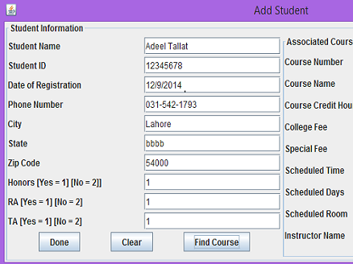
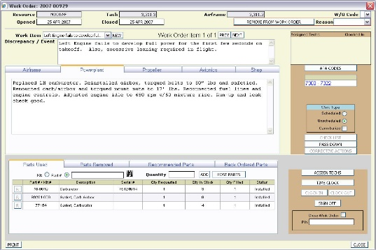
P2.1 – IT System Proposal
The student registration system – All students in schools in the UK need to attend a certain number of days and this attendance level needs to be monitored. It is a very specific and necessary thing. Without student attendance tracking, students will skip days without reason or parental consent. A school system needs to track the number of attended days and possibly be able to contact parents when the number drops.
The monitoring of student grades – Tracking student grades is not essential but is useful, to track grades over time and across subjects allows schools to put measures in place in order to improve these grades. Schools are all about progressing student education. To interpret and deal with issues is essential for that.
The control of stock and resources in the Academy e.g. paper, pens and equipment – Anything that requires money to be spent needs to be tracked, the risk of theft, loss, or over spending is something schools deal with all the time and an accounts tracking system manages that risk. Tracking stationary orders, tracking capital purchases, tracking equipment spends and budgets in schools usually runs through the school management system, an essential tool for tracking orders.

Slide 10
P2.1 – IT System Proposal
For example, the report should be laid out as such but with more detail. Answer each statement:
The student registration system –
Purpose – State the need for a student registration system, what are the legal requirements, why does tracking students help the school, what are the benefits and possible risks.
Viability – How difficult would it be to install, what is the timescale, what information is required to make it functional.
Intended users – Who are the users, who inputs the information, who accesses the information, who gets to deal with the information after it has been input.
Cost – How much is a system likely to cost in terms of program and data and human input. How much is it likely to cost to run each year.
Hardware and software equipment – What equipment is likely to be needed, research a version and find the hardware and software required. How much storage will it take for the program and the data.
Security – How should it be restricted in terms of student, teacher, technician, manager access, when should the information be backed up
Recovery – What management and recovery level should be integrated if the system crashes.

Slide 11
M1.1 – Meeting System Specification
Progress Academy has stated the priority requirements that their IT system must have. These include:
printing documentation and scanning documents or images;
storing up to 500GB of information and images;
transferring data to hand held devices, e.g. tablets or laptops;
specialist display devices where appropriate;
hosting video conferencing;
a simple and easy to use graphical user interface;
networking functionality to enable files transfer and sharing;
a range of suitable software applications appropriate for teaching staff and students;
internet access including appropriate security measures;
authorised user only access;
appropriate backup and recovery systems.
M1.1 – Task 02 – In your proposal, describe how the priority requirements might be met by integrating each of the three systems.
For this task, you do not have to specify each requirement, some will be met by student tracking, some by inventory tracking. Decide which should be met and how.

Slide 12
P2.2 – IT System Proposal Needs
For example, a Student registration System would meet the following proposal requirements:
scanning documents or images – Student photographs would need to be incorporated into the system to help the teacher track students in classes so they can be recognised. This will allow the teacher to accurately register the students, improving the security of the data,
storing up to 500GB of information and images – only images of the students will be stored reducing down the size of the data, the student tracking data will be very small as it is just numbers and symbols which reduces the file size.
transferring data to hand held devices, e.g. tablets or laptops – Staff may need to access this data on the move, for example PE teachers so the information needs to be accessible either via cloud, Wi-Fi or copied across for each lesson and copied back when registered.
This is the expected level of detail you will need to write for each. For student registration you will need to also cover with reasons for:
a simple and easy to use graphical user interface -
networking functionality to enable files transfer and sharing -
a range of suitable software applications appropriate for teaching staff and students -
internet access including appropriate security measures -
authorised user only access -
appropriate backup and recovery systems -
Why do teachers do registers each lesson What happens if my attendance drops below 95%. Who will know? What Management System does my school have Can I see my own grades How much data is automated and how much needs to be typed.

Slide 13
LO2 – Assessment Criteria
P2.1 – Task 01 - Propose an IT system to meet specified business needs of purpose, viability, intended users, cost, hardware and software equipment, security, recovery.
M1.1 – Task 02 – In your proposal, describe how the priority requirements might be met by integrating each of the three systems.

